Slide 1
How to debug a website using IE F12 tools
David Catuhe | Principal Program Manager
Etienne Margraff | Technical Evangelist

Slide 2
Course Topics
How to debug a website using IE F12 tools
01 | Working with web standards | 02 | Debugging with the console and the debugger windows
03 | Optimizing your page | 04 | Developing a mobile web site
05 | Testing on all browsers

Slide 3
03 | Optimizing your page
David Catuhe | Principal Program Manager
Etienne Margraff | Technical Evangelist

Slide 4
Module Overview
DOM explorer
Network
UI Responsiveness
Memory profiler

Slide 5
Optimizing your page DOM Explorer

Slide 6
DOM Explorer
The first tab in the tools is the DOM Explorer
Allows you to inspect the current state of the DOM
Can choose an element and modify it’s attributes, and CSS styles
Turn on highlighting to see where each element falls in the DOM
Can also access by right clicking an element and choosing " Inspect Element"
Notes:
The dom explorer is very useful for finding out what’s happening at the current moment rather than just “view source”

Slide 7
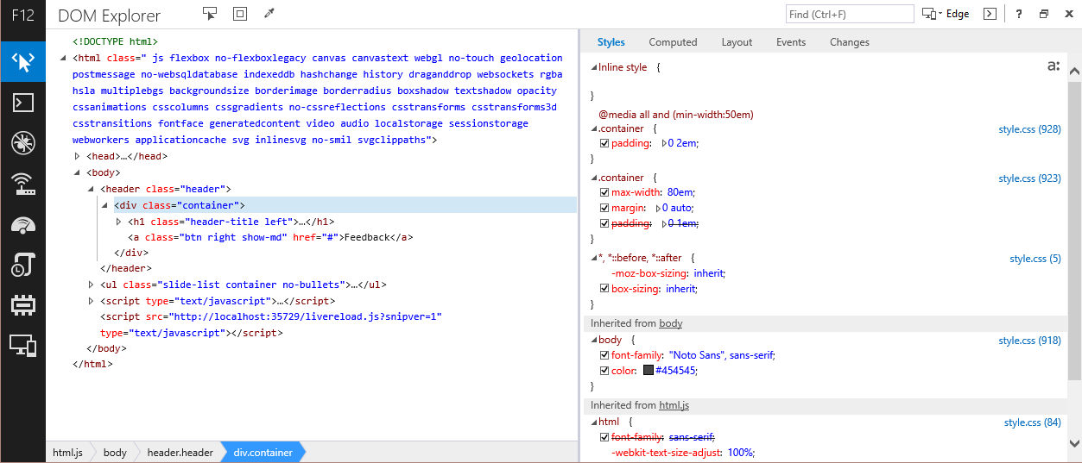
DOM Explorer
Notes:
Click an element to view it’s css properties.
You can see the current styles in the styles tab
You can see the entire DOM tree on the left

Slide 8
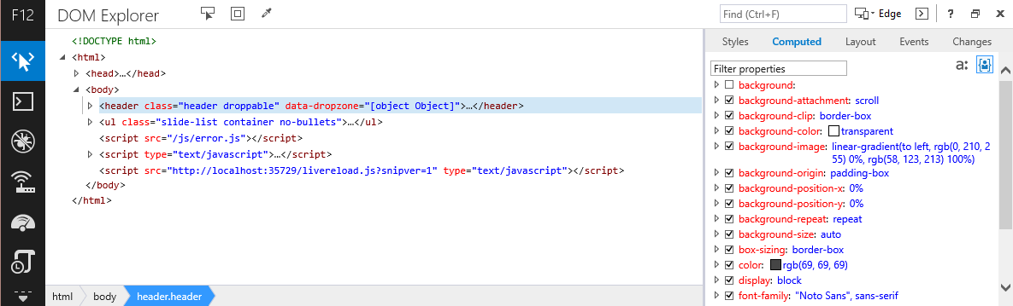
DOM Explorer
Notes:
Here you can see the computed styles for this element.

Slide 9
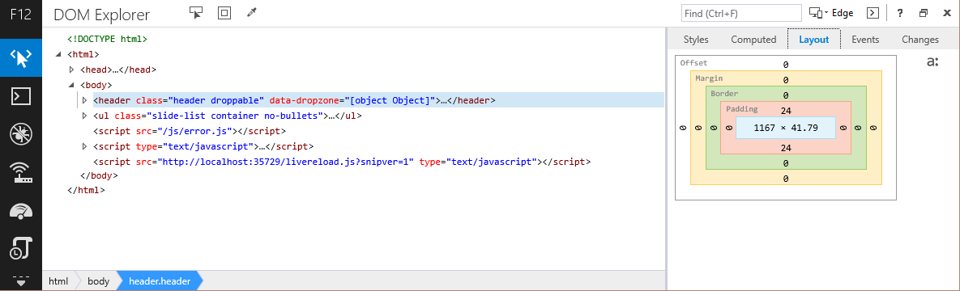
DOM Explorer
Notes:
Here you can see the computed styles for this element.

Slide 10
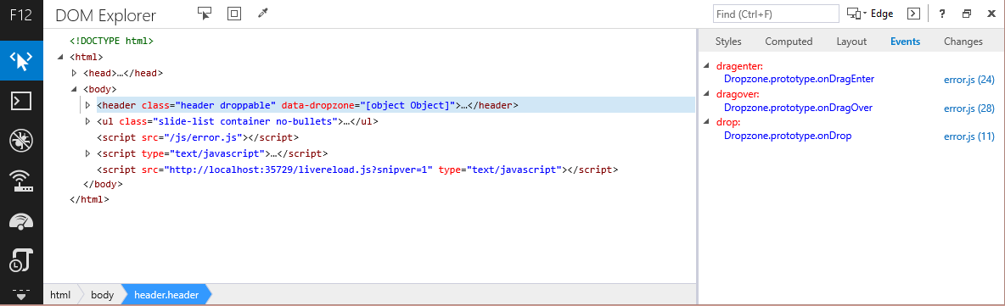
DOM Explorer
Notes:
Here are any dom events on the element and their location in the JavaScript code

Slide 11
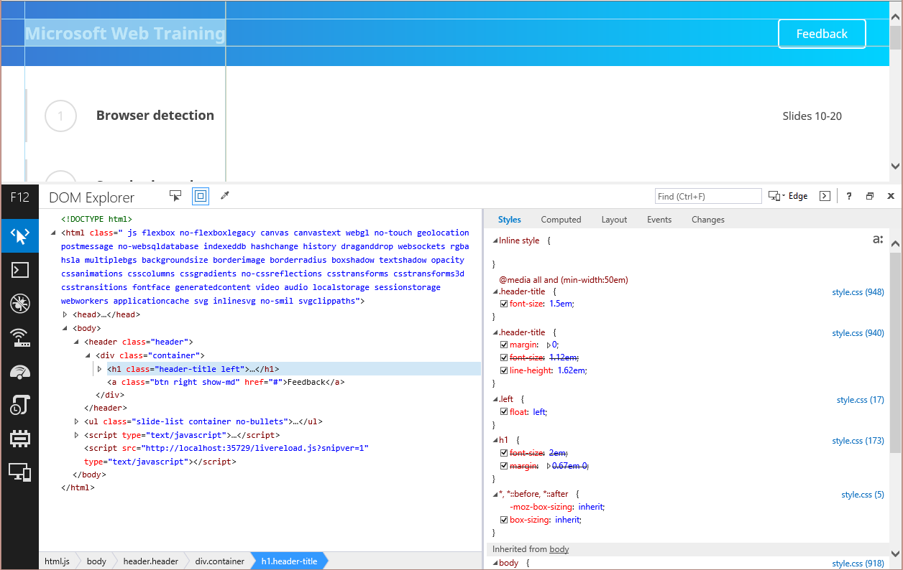
DOM Explorer
Notes:
Here you can see element highlighting is active

Slide 12
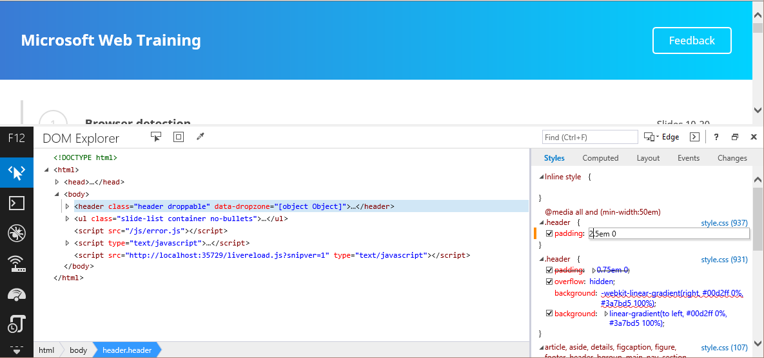
DOM Explorer
Notes:
Can edit the styles of an element.
Changes show up in the changes tab.

Slide 13
Optimizing your page Demo

Slide 14
Optimizing your page Network

Slide 15
Network
Inspect incoming traffic
Look at headers, JSON and XML data
Helpful debugging Ajax requests
Helpful to find large files that could be compressed

Slide 16
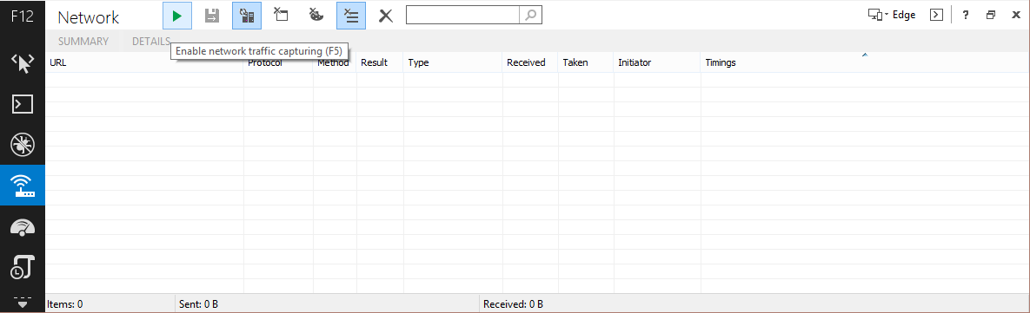
Network
Enable traffic monitoring, then refresh

Slide 17
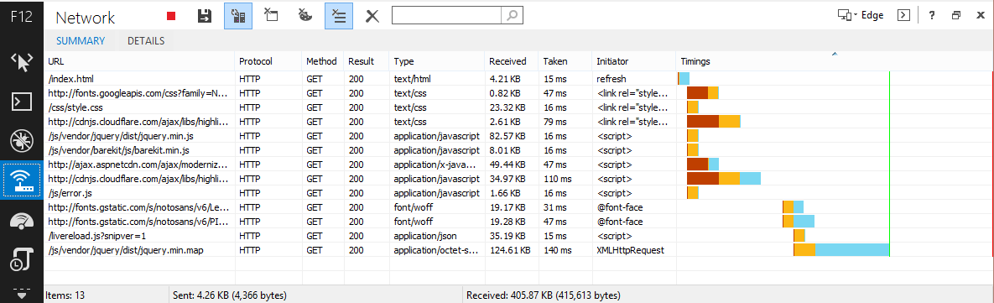
Network
Shows HTTP method and result
Type, size, and time to download, as well as what requested the download

Slide 18
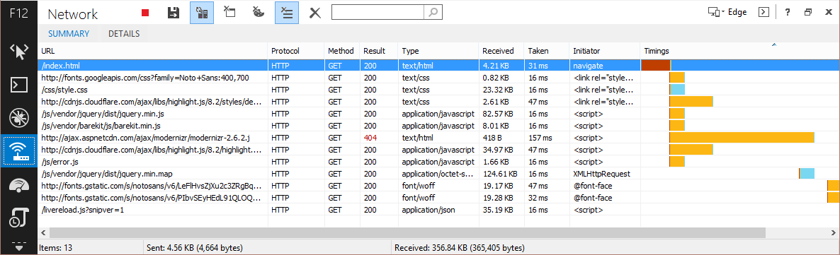
Network
Find server errors such as 400, 404, and 500
Here you can see modernizr.js was misspelled in the code to just .j

Slide 19
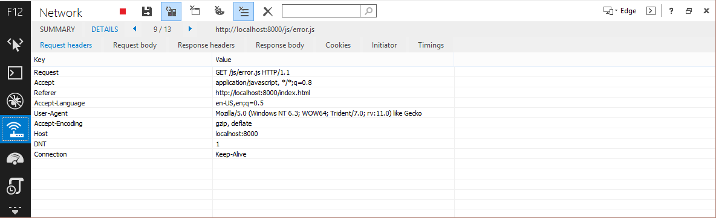
Network
Get all the details about a specific request

Slide 20
Optimizing your page Demo

Slide 21
Ajax Debugger Example
var xhr = new XMLHttpRequest();
xhr.open("GET", "https://api.twitter.com/1.1/search/tweets.json?q=%40twitterapi");
xhr.onreadystatechange = function () {
if (xhr.readyState === 4) {
if (xhr.status === 200) {
console.log(xhr.responseText);
}
}
};
xhr.send();
Notes:
Here’s an example of an ajax request to twitter

Slide 22
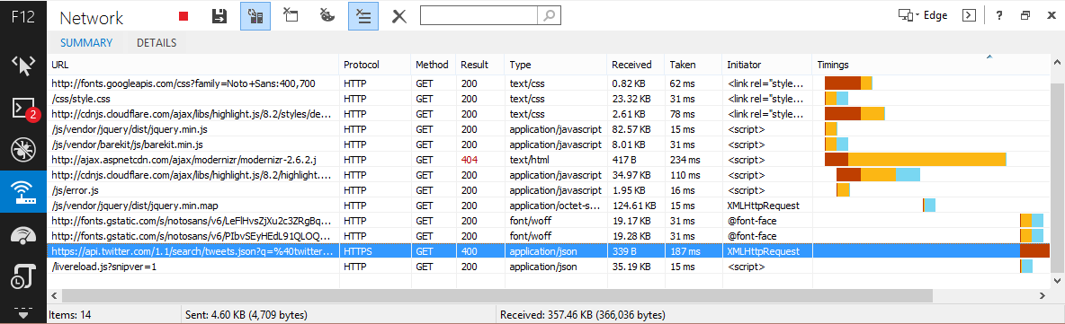
Ajax Debugger Example
Can see a 400 error

Slide 23
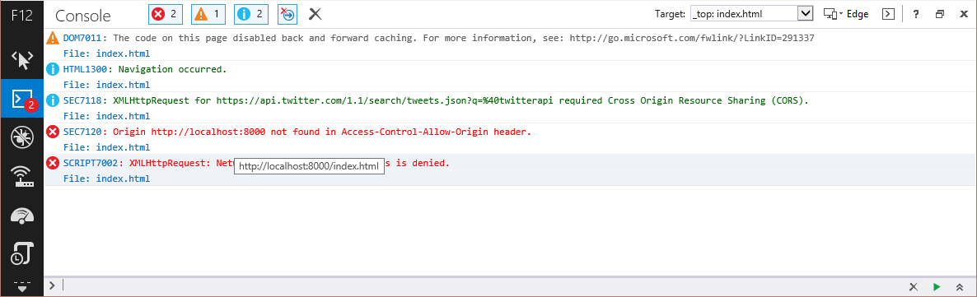
Ajax Debugger Example
Can also see the CORS error in the console

Slide 24
Optimizing your page UI Responsiveness

Slide 25
UI Responsiveness
Allows you to measure page performance relatively to layout rendering
Users can emit their own markers
Helpful to find bottlenecks associated with timers or heavy DOM elements
Notes:
The dom explorer is very useful for finding out what’s happening at the current moment rather than just “view source”

Slide 26
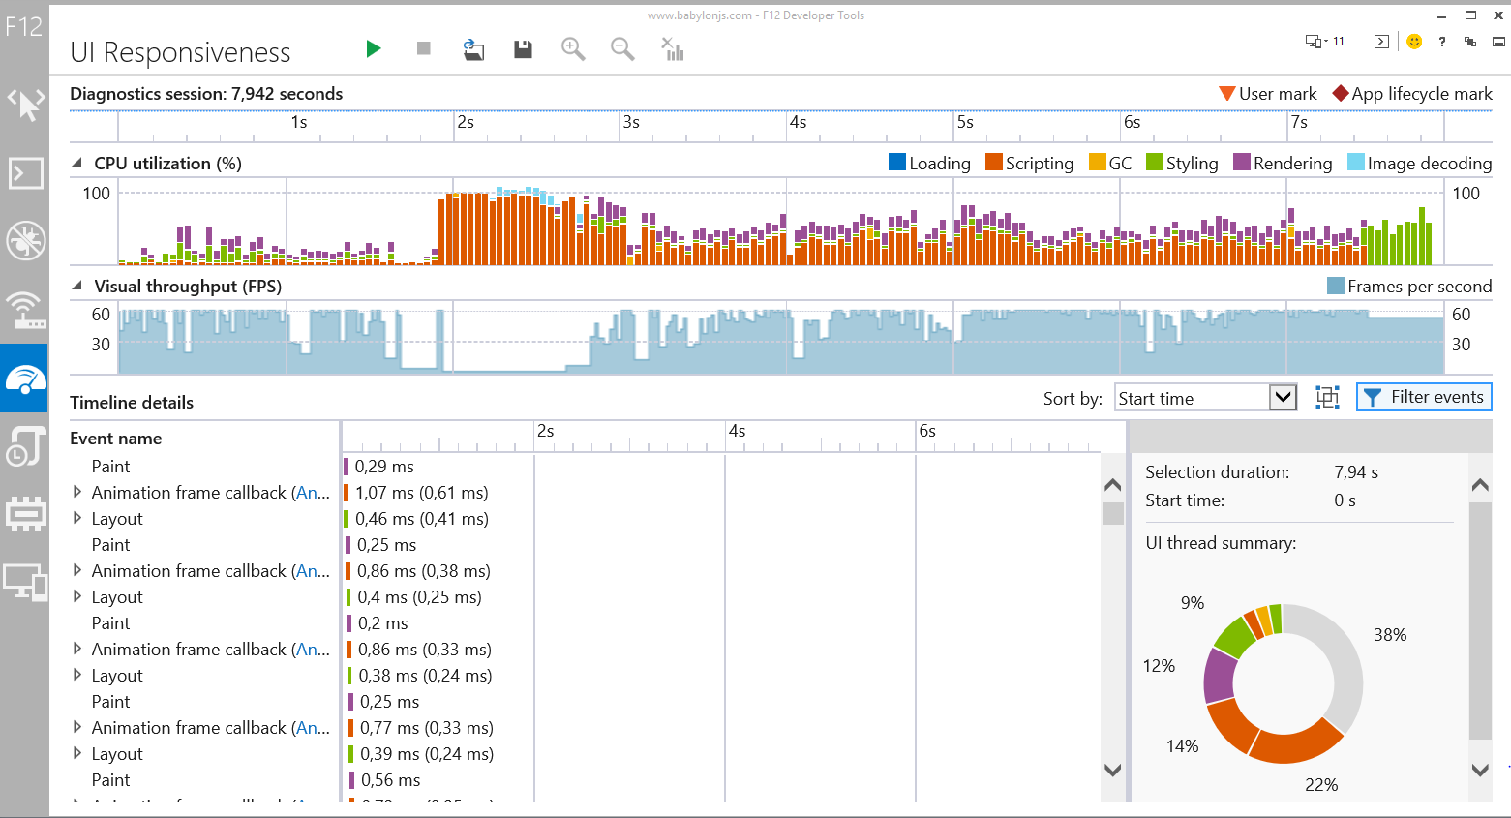
UI Responsiveness diagrams

Slide 27
Optimizing your page Memory profiler

Slide 28
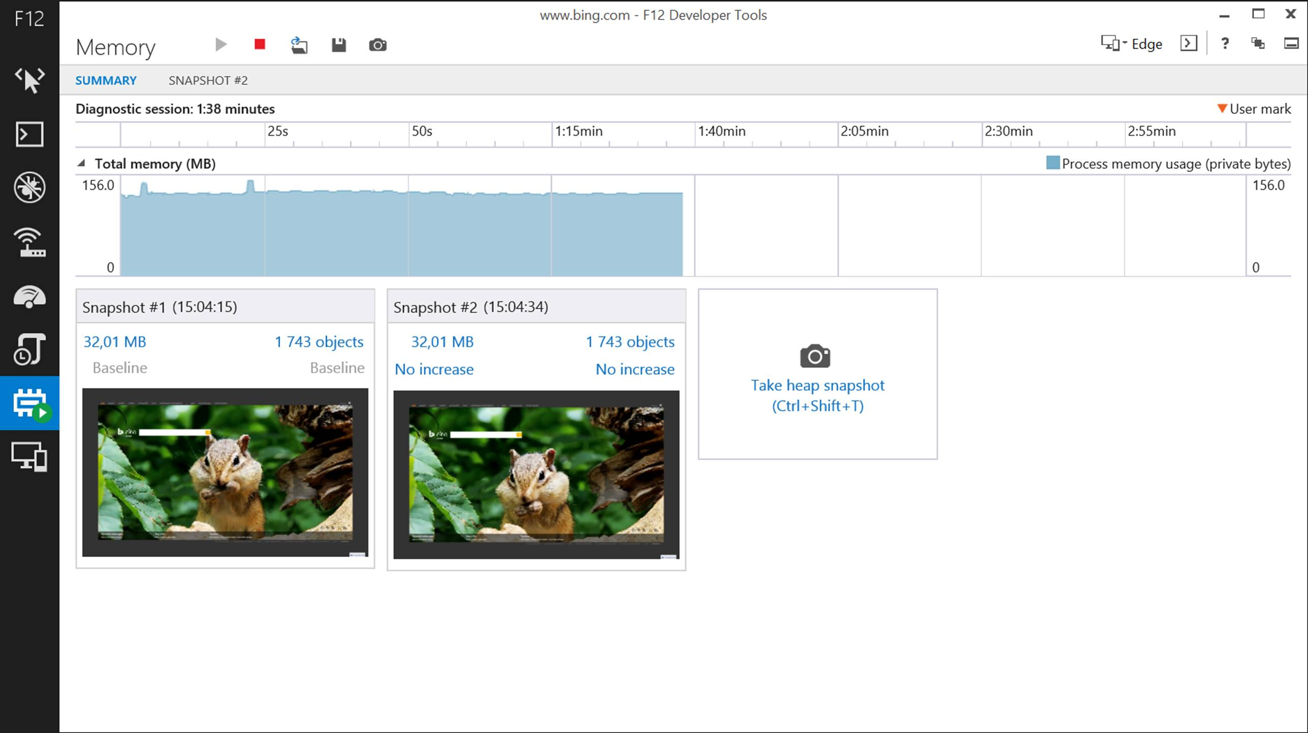
Memory profiler
Help you find memory holes
Filters automatically applied to figure out which elements are really impactful
Notes:
The dom explorer is very useful for finding out what’s happening at the current moment rather than just “view source”

Slide 29
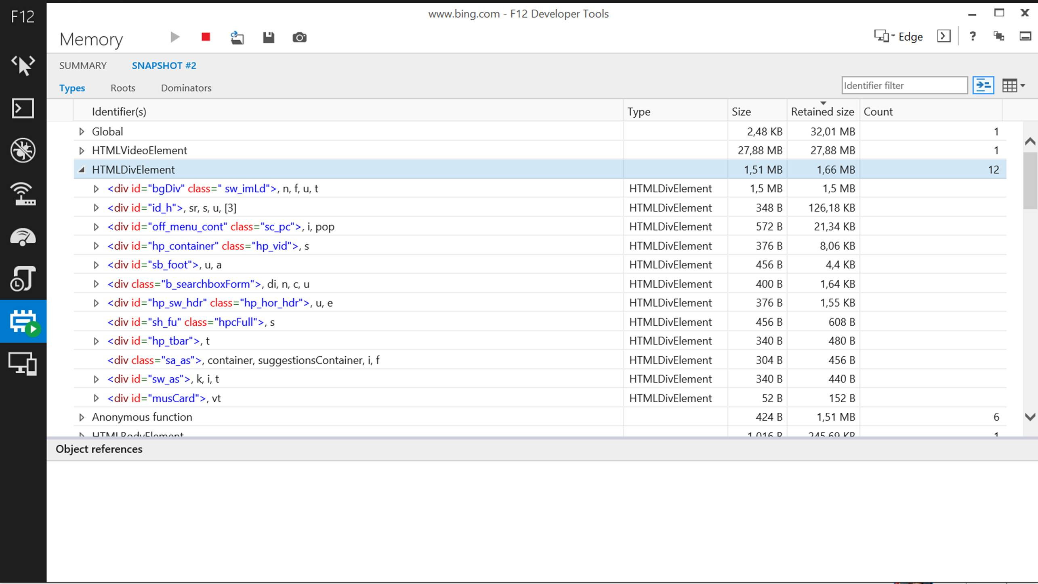
Detailed data

Slide 30
Optimizing your page Demo

